Slide 1
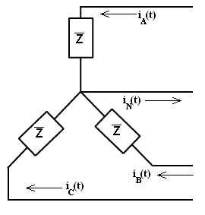


Why Triplens Add in the Neutral of a
Four-wire Three-phase Transmission Line
KCL gives the current in the neutral line:
i_{A}(t), i_{B}(t) and i_{C}(t) are 120º out of phase. Consider a case where the currents only consist of a fundamental and a third harmonic:

Slide 2

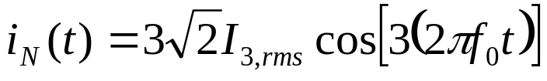
Note that each triplen may be simplified:
So the third harmonics from each current are in phase
When summed to find i_{N}(t), the fundamental components cancel, as expected, but the third harmonics add since they are in phase.

